Slide 1



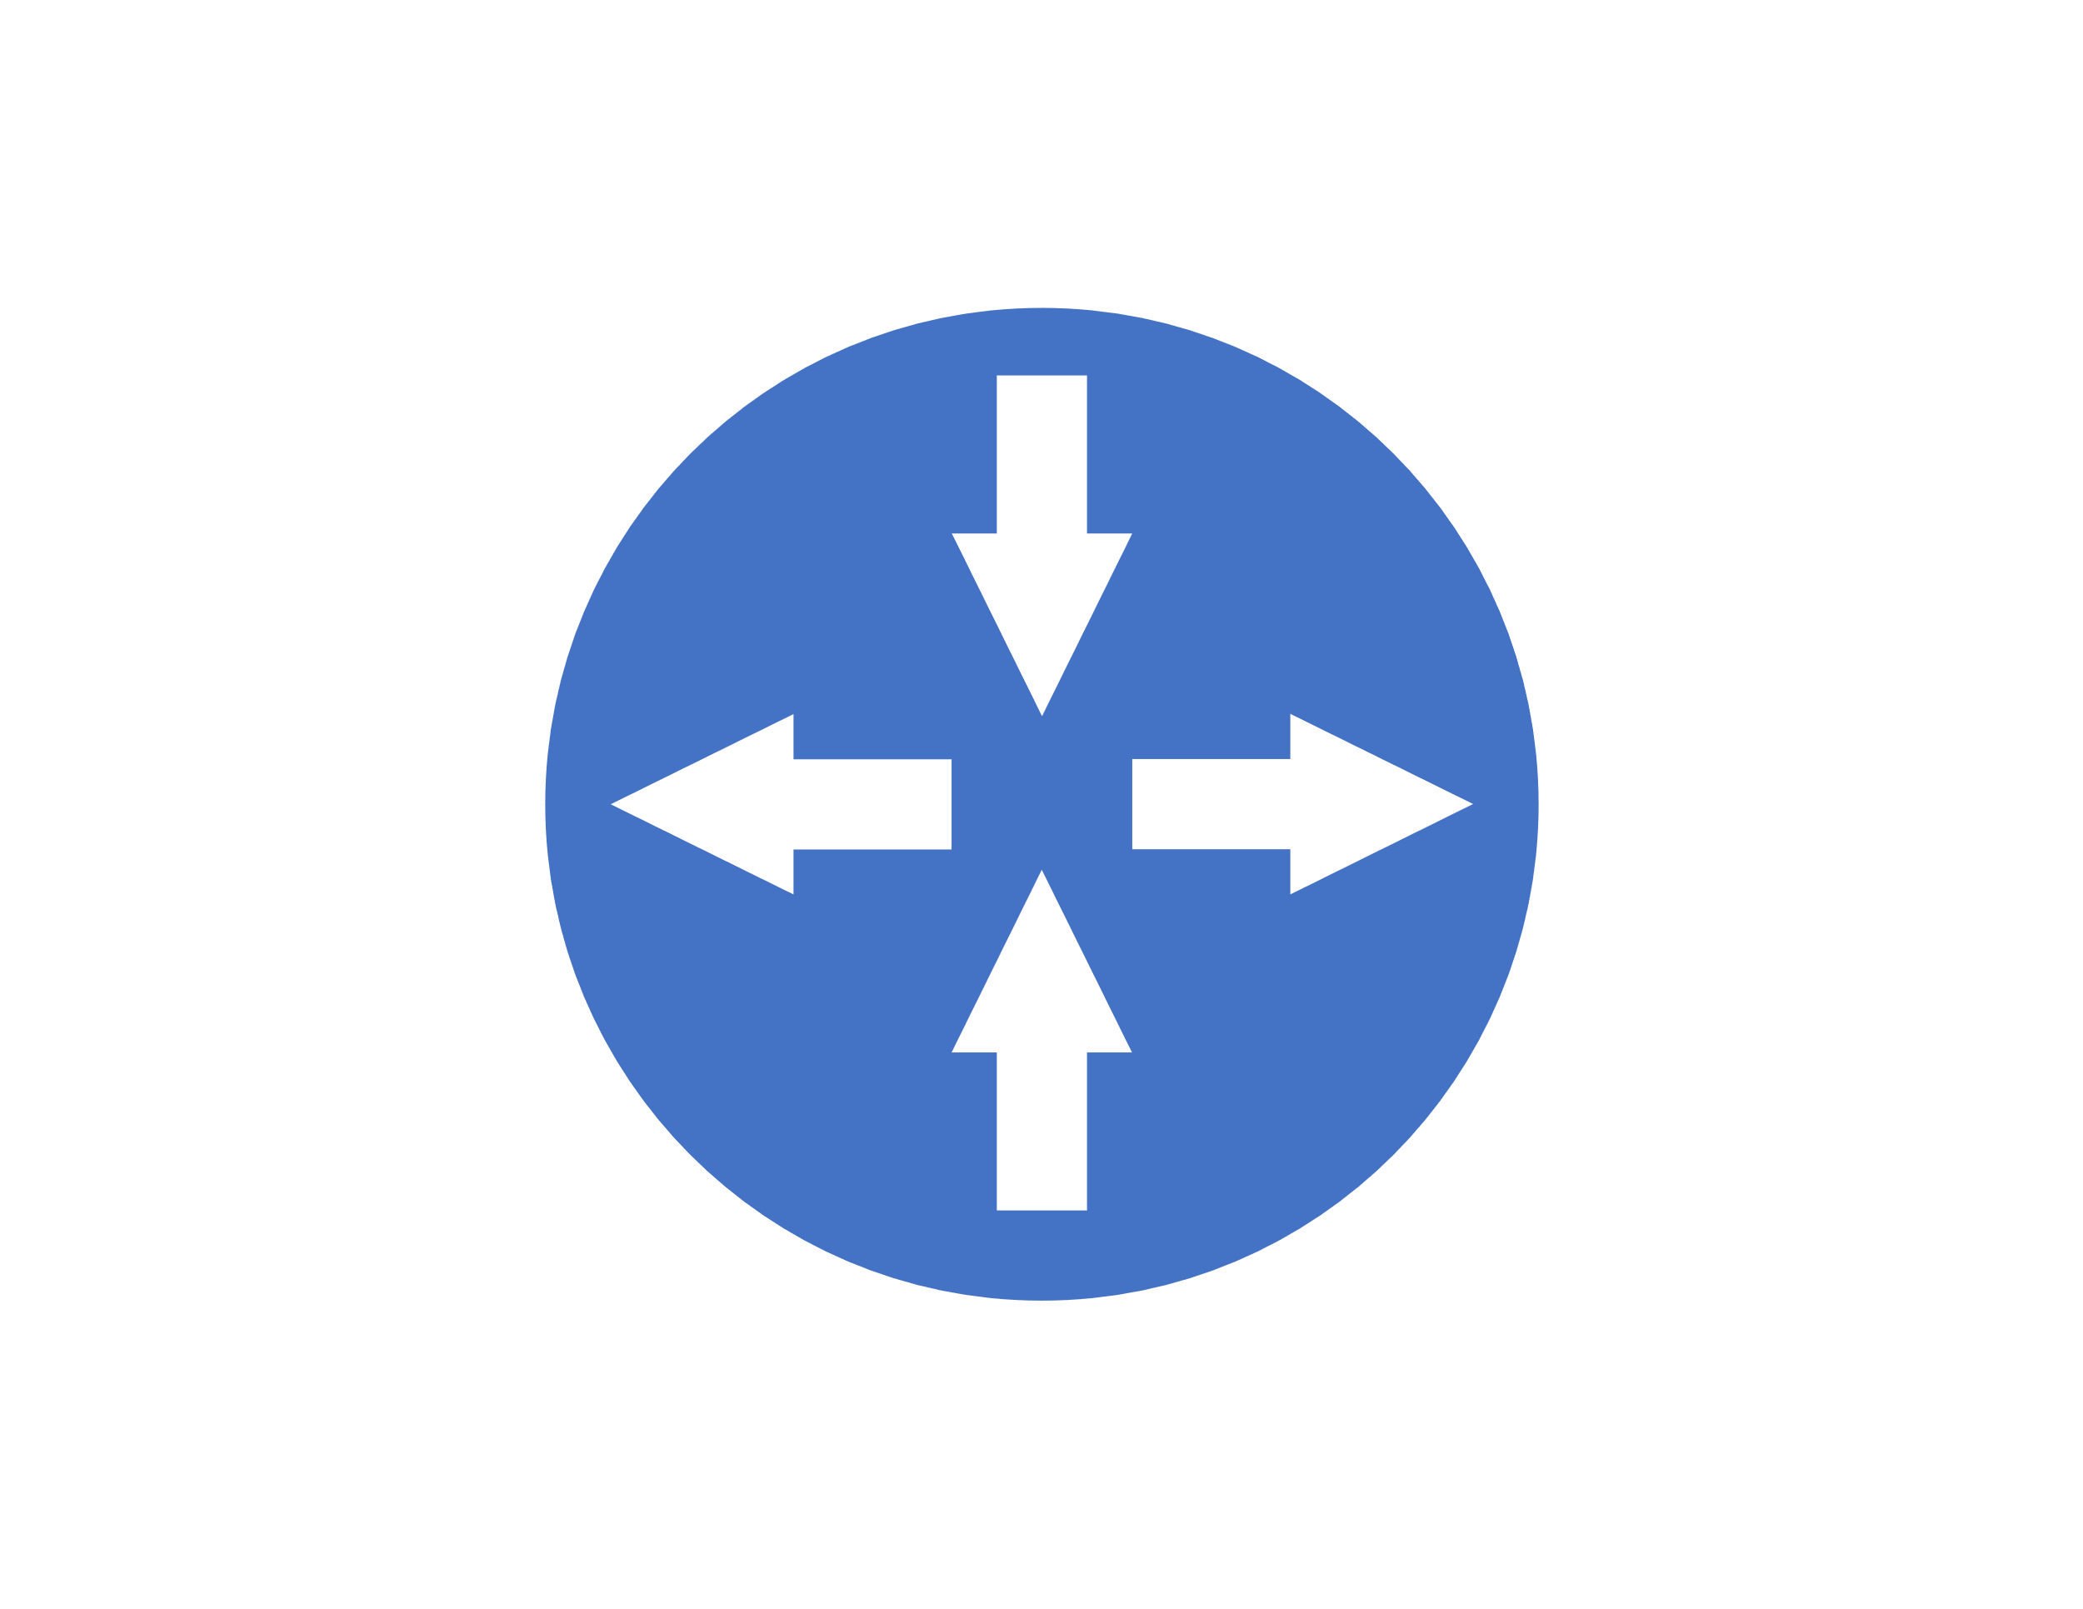



On Premises
RRAS Server
Domain Controllers
VPN Tunnel
AD Sync via VPN
VPN Gateway
DCVM
West Central US

Slide 2



Web VMs (Availability Set)
E:\Data
SQL VM (Single)
F:\Logs F:\Backups
West Central US

Slide 3






AlwaysOn Availability Group
Availability Zone 1
Zone Redundant

Slide 4
Availability Zone 1
Zone Redundant
Availability Zone 2
WebVM1
WebVM2
AlwaysOn Availability Group
SQLVM1
SQLVM2
Cloud
Witness
DCVM1
DCVM2

Slide 5

Branch Location
RRAS Cluster
ISP 1
ISP 2
Availability Zone 1
Availability Zone 2
Active-Active VPN Gateway

Slide 6

Availability Zone 1
Zone Redundant
Availability Zone 2
Availability Zone 1
Zone Redundant
Availability Zone 2
Azure Site Recovery
WebVM1
WebVM2
WebVM3
WebVM4
AlwaysOn Availability Group
Async Replication
SQLVM1
SQLVM2
SQLVM3
SQLVM4
Cloud
Witness
DCVM1
DCVM2
DCVM1
DCVM2
Central US
East US 2

Slide 7
Front Door
Availability Zone 1
Zone Redundant
Availability Zone 2
Availability Zone 1
Zone Redundant
Availability Zone 2
Azure Site Recovery
Azure Backup
WebVM1
WebVM2
WebVM3
WebVM4
AlwaysOn Availability Group
Async Replication
SQLVM1
SQLVM2
SQLVM3
Cloud
Witness
DCVM1
DCVM2
DCVM1
DCVM2
Central US
East US 2

